Slide 1
Data Analyst Nanodegree
Session 4
Conducted by: Hamza
Notes:
https://udacity.zoom.us/j/7991233356
<number>

Slide 2

SUPPORT / REPO
fwd-support@udacity.com
https://github.com/santarabantoosoo/Data-Analysis-NanoDegree-2.0
Notes:
<number>

Slide 3
Agenda
When not to use inferential statistics!
Project
Conditional probability and bayes rule
Real life exercise (encounter the normal distribution)
Bayesian project
Notes:
<number>

Slide 4
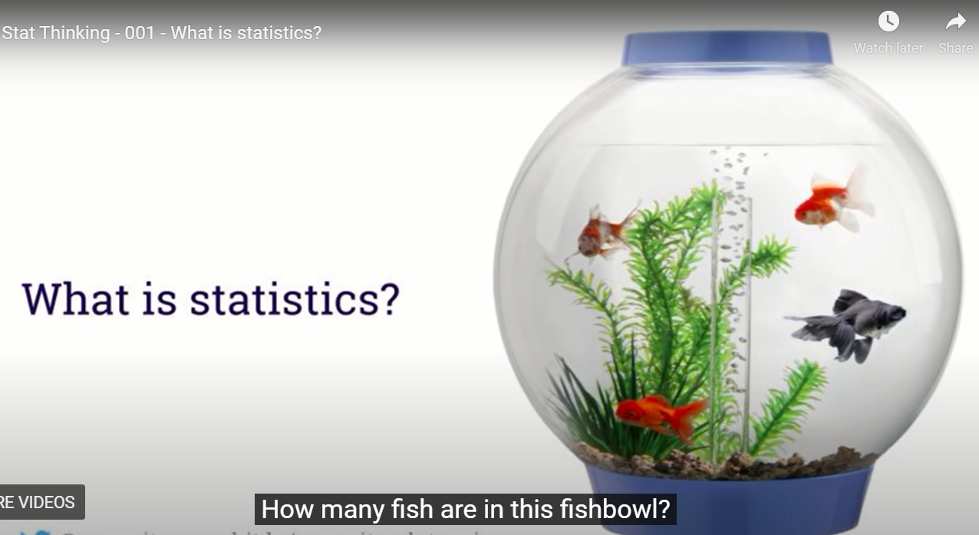
When not to use statistics?
Notes:
Let’s call them goldfish
<number>

Slide 5
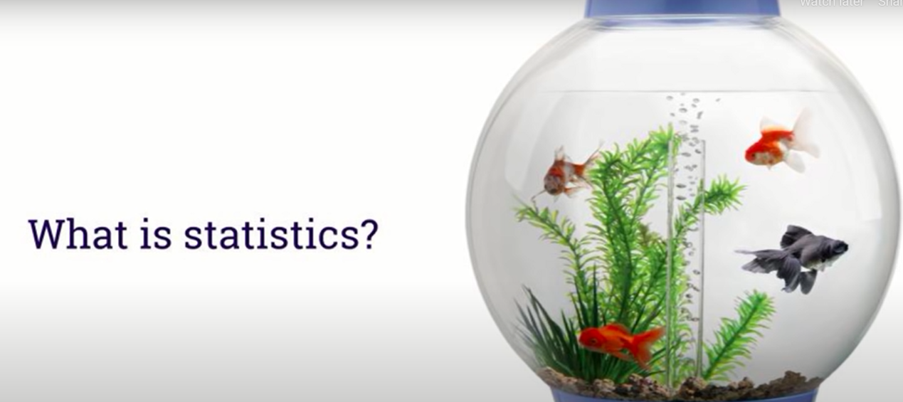
Different colors?
Notes:
Can gold fish in general have different colors?
<number>

Slide 6
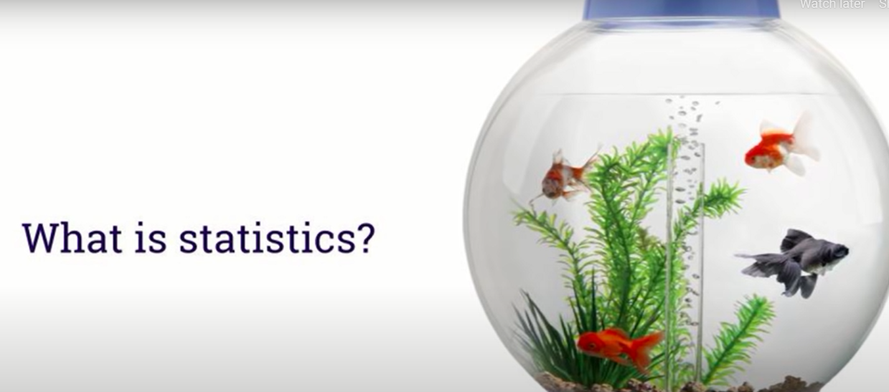
Gold .. Not gold?
Notes:
Can a gold fish have a non-gold color ? Yes
<number>

Slide 7
Are these questions about data?

Slide 8
Are these questions about data?
Yes
Are these questions about statistics?

Slide 9
Are these questions about data?
Yes
Are these questions about statistics?
No!

Slide 10
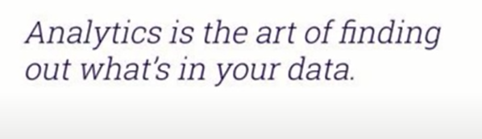
Going beyond the data?
Notes:
Sine we are describing our dataset, that’s data mining or analytics or descriptive statistics
<number>

Slide 11
Different colors?
Why not stats?
Notes:
Because u are certain about the answer
<number>

Slide 12
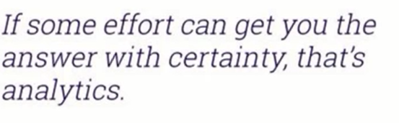
Different colors?
Notes:
<number>

Slide 13
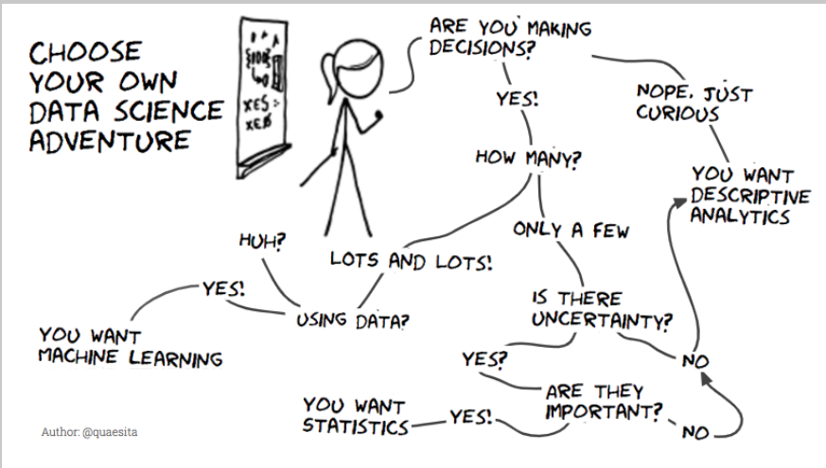
Notes:
Is there uncertainty?
<number>

Slide 14
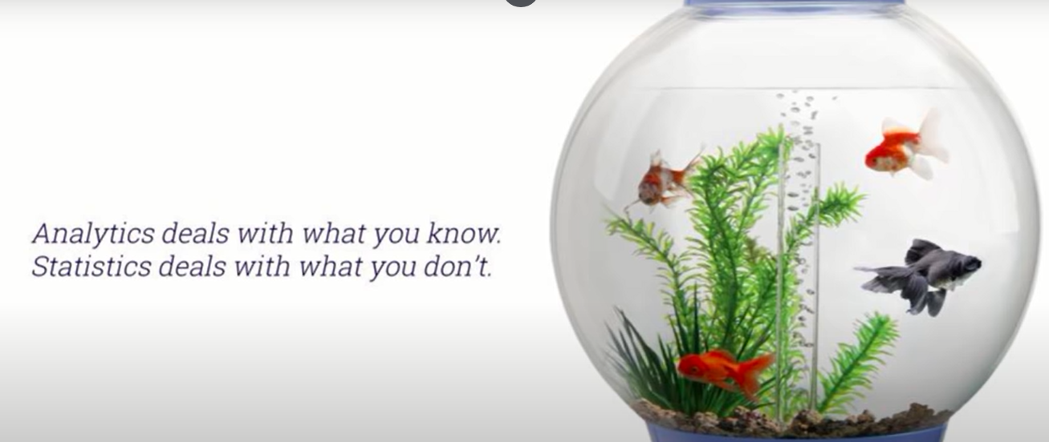
Statistics vs analytics

Slide 15
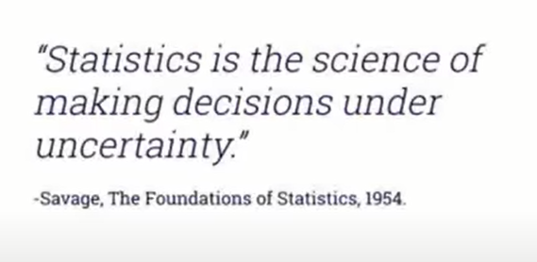
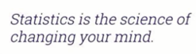
Statistics

Slide 16
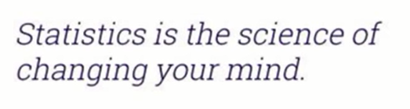
My mind?

Slide 17
My mind?
Prior belief
Default action
Notes:
<number>

Slide 18
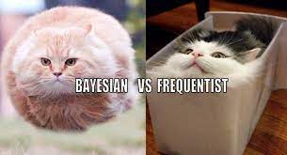
My mind?
Prior belief
Default action
Notes:
<number>

Slide 19

PHD statistics
Notes:
U don’t want to have PhD in stats without knowing when to use statistics
<number>

Slide 20
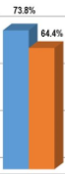
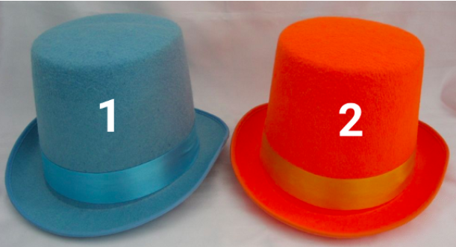
indifferent
Notes:
If you’re indifferent between these hats to begin with and you get more votes for blue than orange, there’s no math in the world that should tell you to pick orange. Math isn’t magic and it doesn’t violate common sense.
<number>

Slide 21
When to choose orange?
Notes:
The only way it makes sense to end up choosing blue is if you had a preference for the blue hat to begin with. Then you’re asking whether the evidence in favor of orange is strong enough. In other words, whether there’s enough data to change your mind. Okay, so how can you tell?
<number>

Slide 22
indifferent
Do I need statistics?
Notes:
No!!!
Don’t waste ur time
<number>

Slide 23
indifferent
What if I am wrong?
Notes:
“But it could be wrong!” Of course it could be wrong, that’s what it means to be uncertain. There’s no mathemagic in the world that can make certainty out of uncertainty. Your best guess might be a mistake, but it is your best guess, which makes any other guess a worse guess and even more likely to be wrong.
<number>

Slide 24
Welcome to uncertainty
What if I am wrong?
Notes:
“But it could be wrong!” Of course it could be wrong, that’s what it means to be uncertain. There’s no mathemagic in the world that can make certainty out of uncertainty. Your best guess might be a mistake, but it is your best guess, which makes any other guess a worse guess and even more likely to be wrong.
<number>

Slide 25
indifferent
0.001 difference?
Notes:
Msh far2a
This is ur best guess
<number>

Slide 26
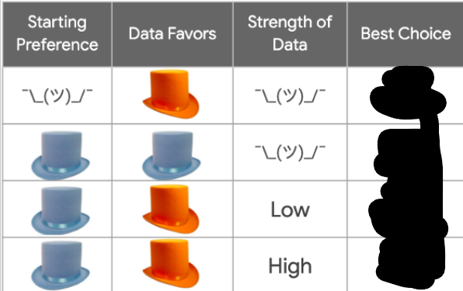
What to choose?

Slide 27
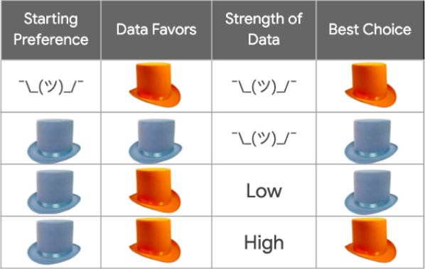

Slide 28
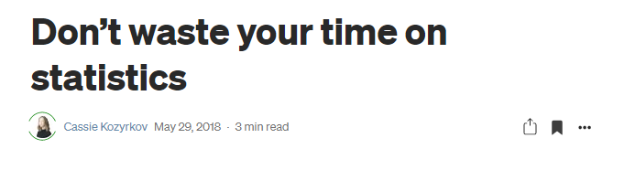
Notes:
Don’t waste your time on statistics | by Cassie Kozyrkov | Towards Data Science
https://towardsdatascience.com/whats-the-point-of-statistics-8163635da56c
<number>

Slide 29
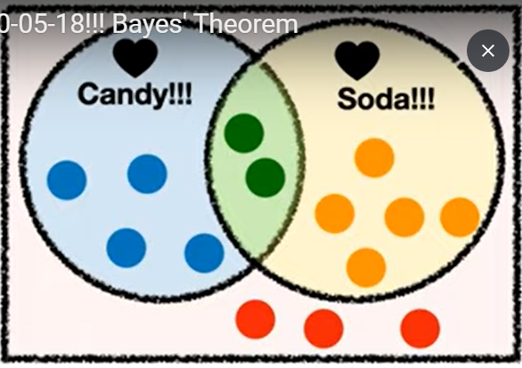
bayes

Slide 30
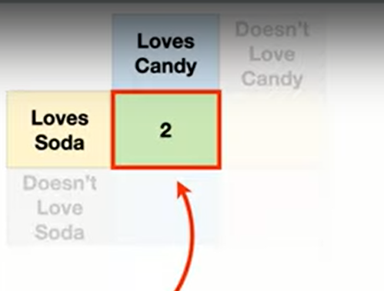

Slide 31
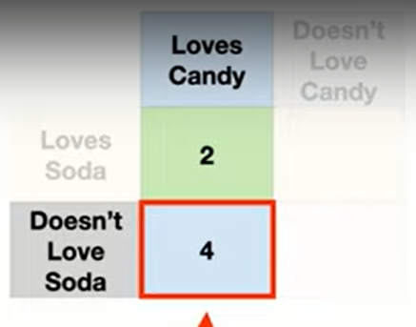

Slide 32
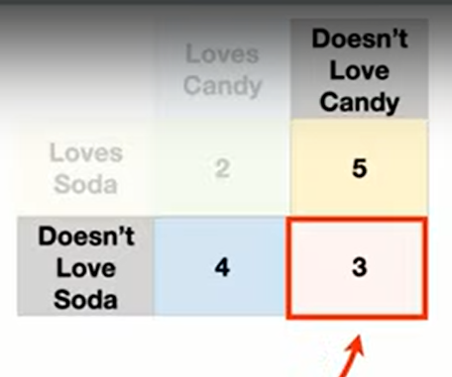

Slide 33
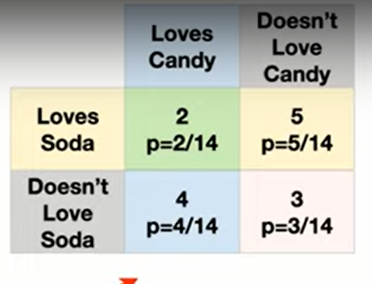

Slide 34
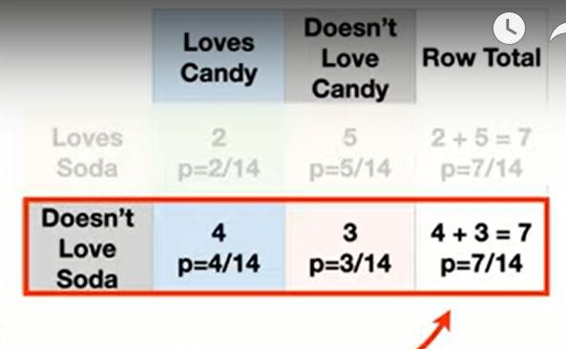

Slide 35
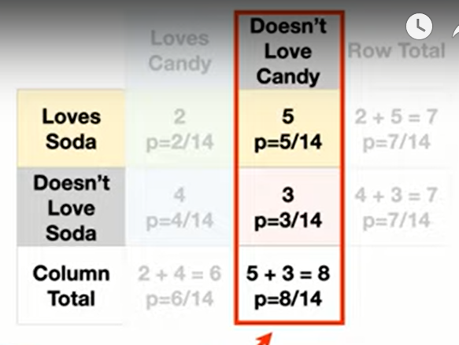

Slide 36
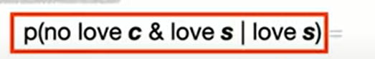
`

Slide 37
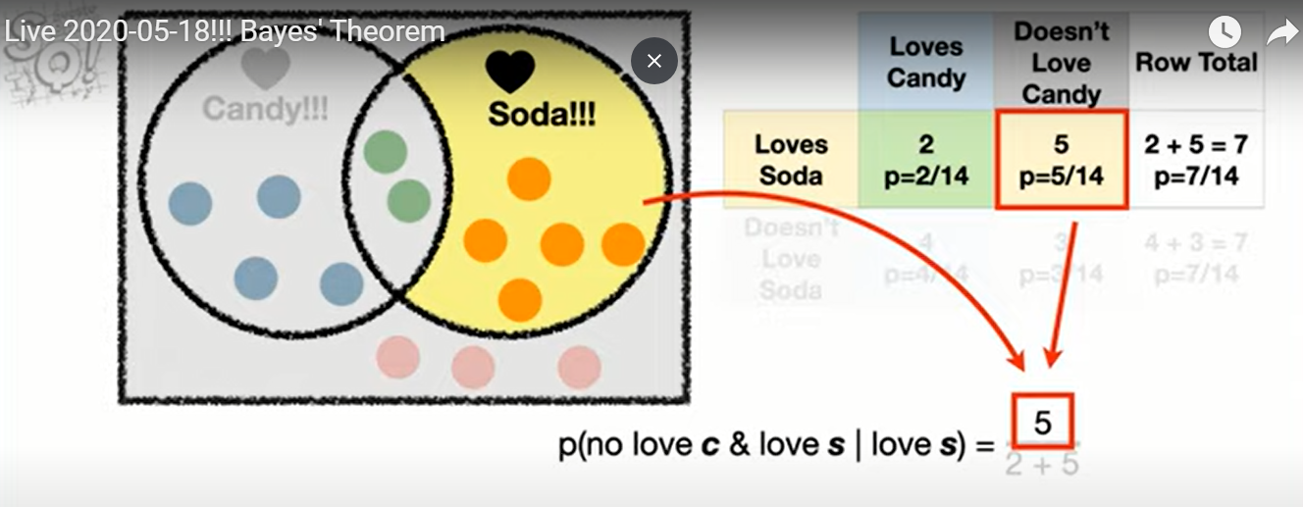

Slide 38
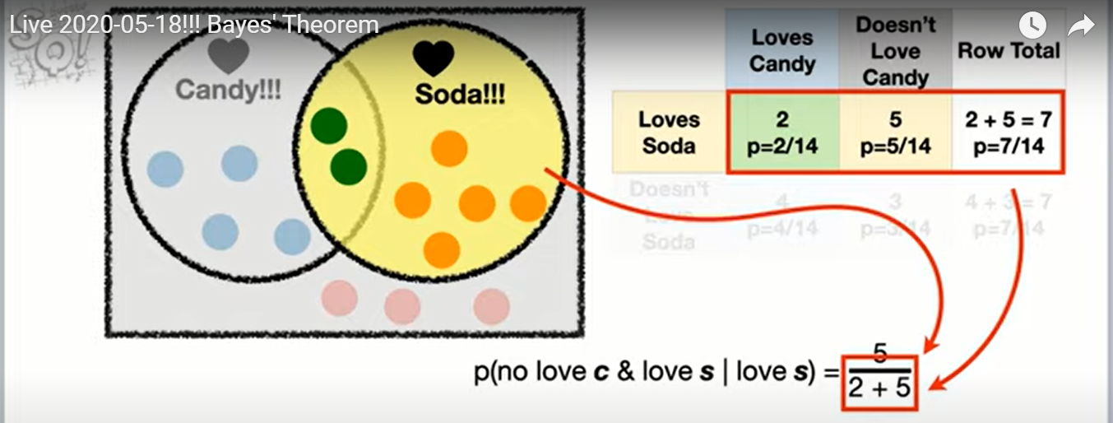

Slide 39
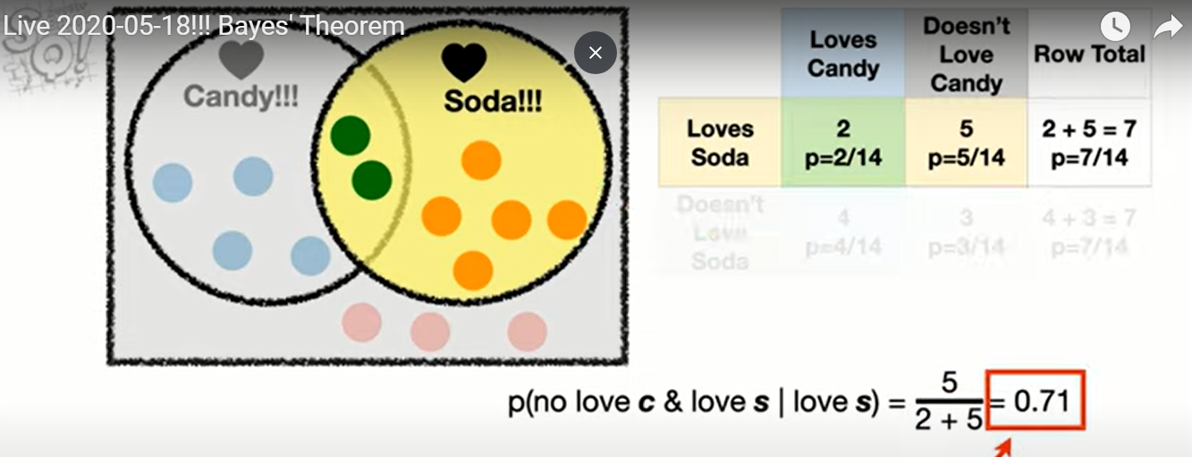

Slide 40
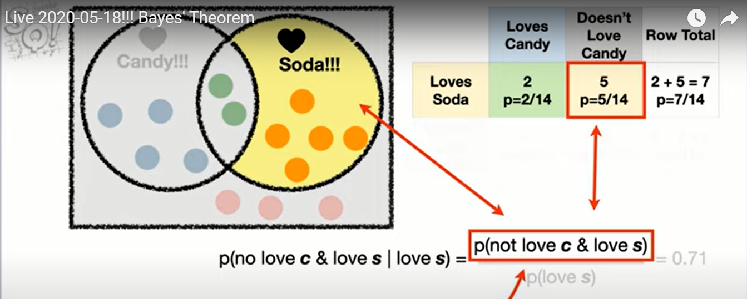

Slide 41
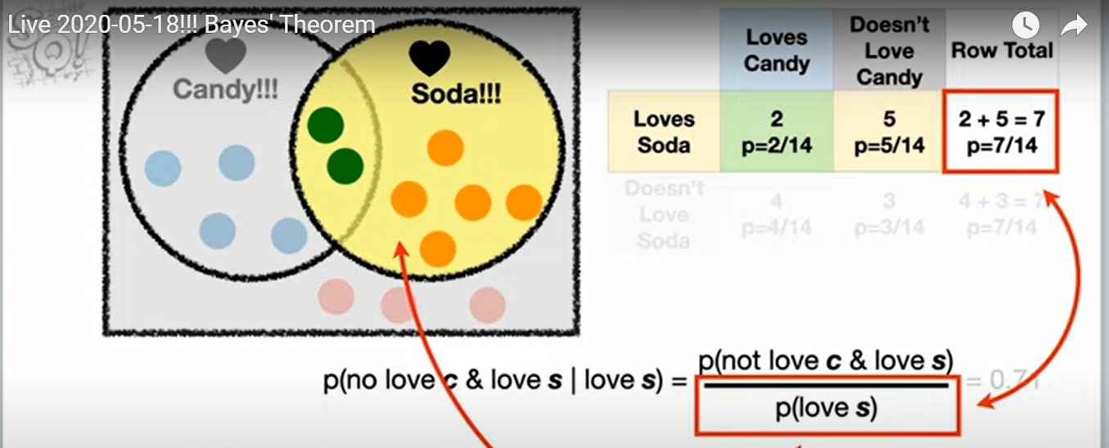

Slide 42
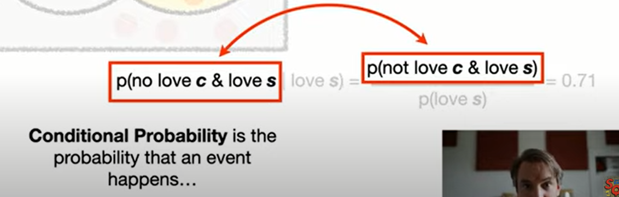

Slide 43
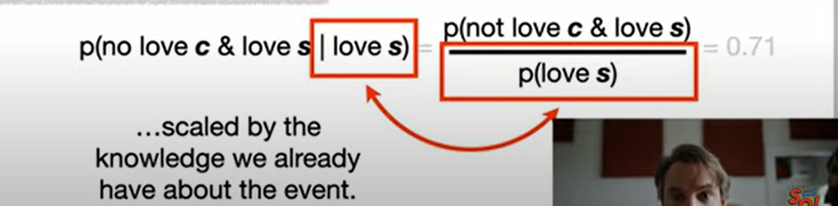

Slide 44
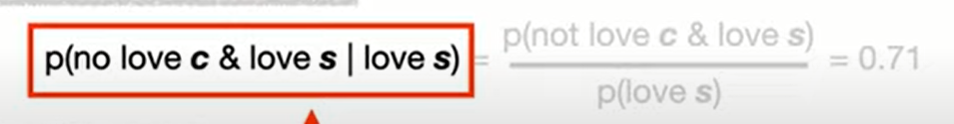
Any redundancy?
Notes:
<number>

Slide 45
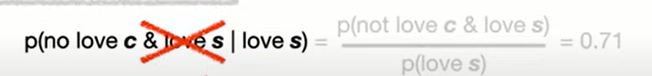
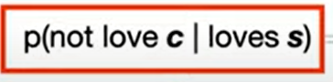
Any redundancy?
Notes:
<number>

Slide 46
Love redundancy ☺
Any redundancy?
Notes:
<number>

Slide 47
Try it yourself
P(love c | no love s)
Notes:
<number>

Slide 48
solution
P(love c | no love s) = 4/7
Notes:
<number>

Slide 49
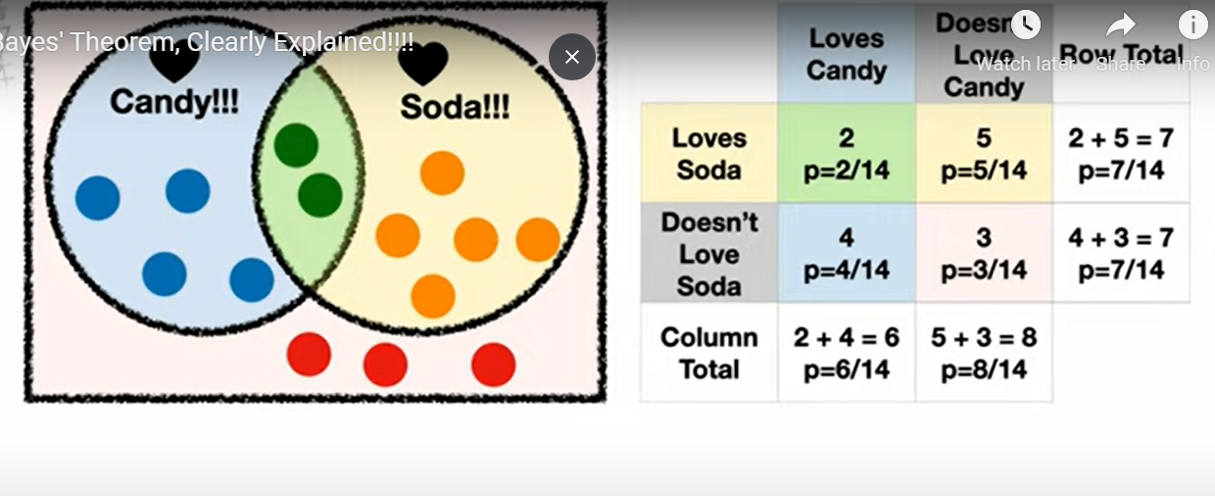
Notes:
Bayes theorem is not a big deal
<number>

Slide 50
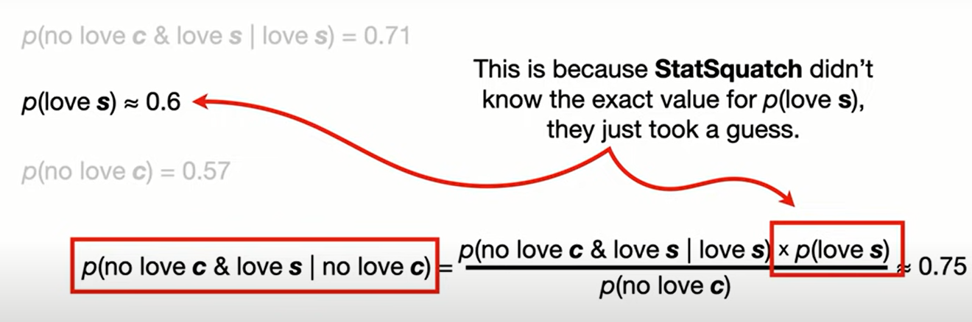
That easy?

Slide 51
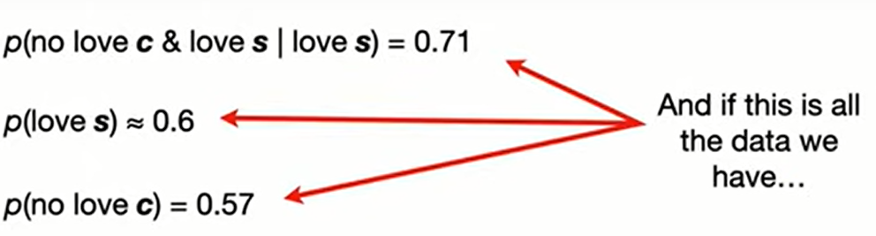

Slide 52
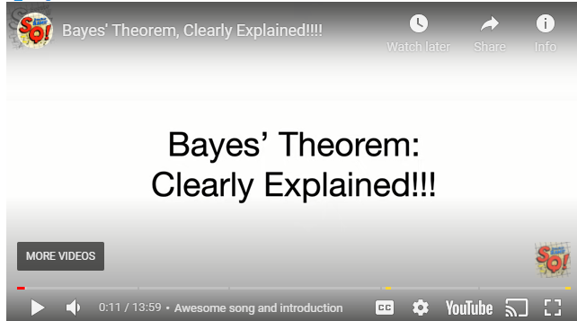
More info?
Notes:
https://statquest.org/bayes-theorem-clearly-explained/
<number>

Slide 53
Bayes exercise
A case study with Conditional probability | Kaggle
https://www.kaggle.com/lakshya91/a-case-study-with-conditional-probability
Check notebook
Check dataset
Explore kaggle

Slide 54
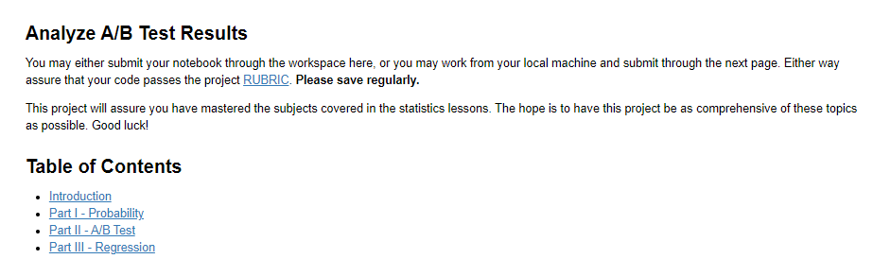
Project

Slide 55
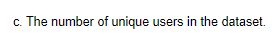
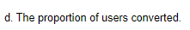
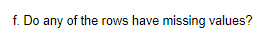

Slide 56
https://review.udacity.com/#!/rubrics/1214/view
Notes:
<number>

Slide 57
Alternative solution
Notebooks for udacity execises
But before this, can our life be easier with NB?
https://medium.com/@maxtingle/10-jupyter-notebook-extensions-making-my-lyfe-easier-f40139a334ce

Slide 58

Bomb on plane
Notes:
humor - What is your favorite "data analysis" cartoon? - Cross Validated
https://stats.stackexchange.com/questions/423/what-is-your-favorite-data-analysis-cartoon/38295#38295
But if you know that "there is a bomb" (yours) in the plane, which we may call event AA, and you are willing to accept that the "existence of a second bomb" (event BB) is independent of AA, then P(B∣A)=P(B)=1/1000P(B∣A)=P(B)=1/1000. Always condition on what you know. And yeah, I deserve a −1−1 for screwing a good joke
<number>

Slide 59
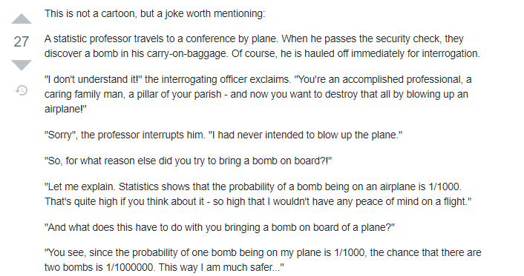

Slide 60
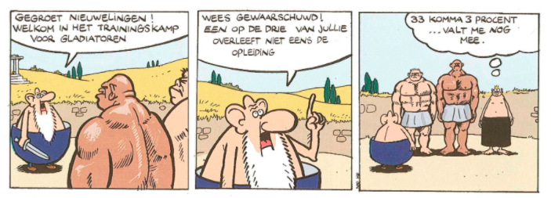
Importance of distribution or conditional probability
Notes:
Greetings new recruits! Welcome to the training camp for gladiators
Be warned! One in three of you does not survive the training
33.3% ... That's not so bad
humor - What is your favorite "data analysis" cartoon? - Cross Validated
https://stats.stackexchange.com/questions/423/what-is-your-favorite-data-analysis-cartoon/38295#38295
As a pointer to why we should think about conditional probabilities (and from then on, to why tools like logistic regression are useful for predicting risk) this is an excellent cartoon.
<number>

Slide 61
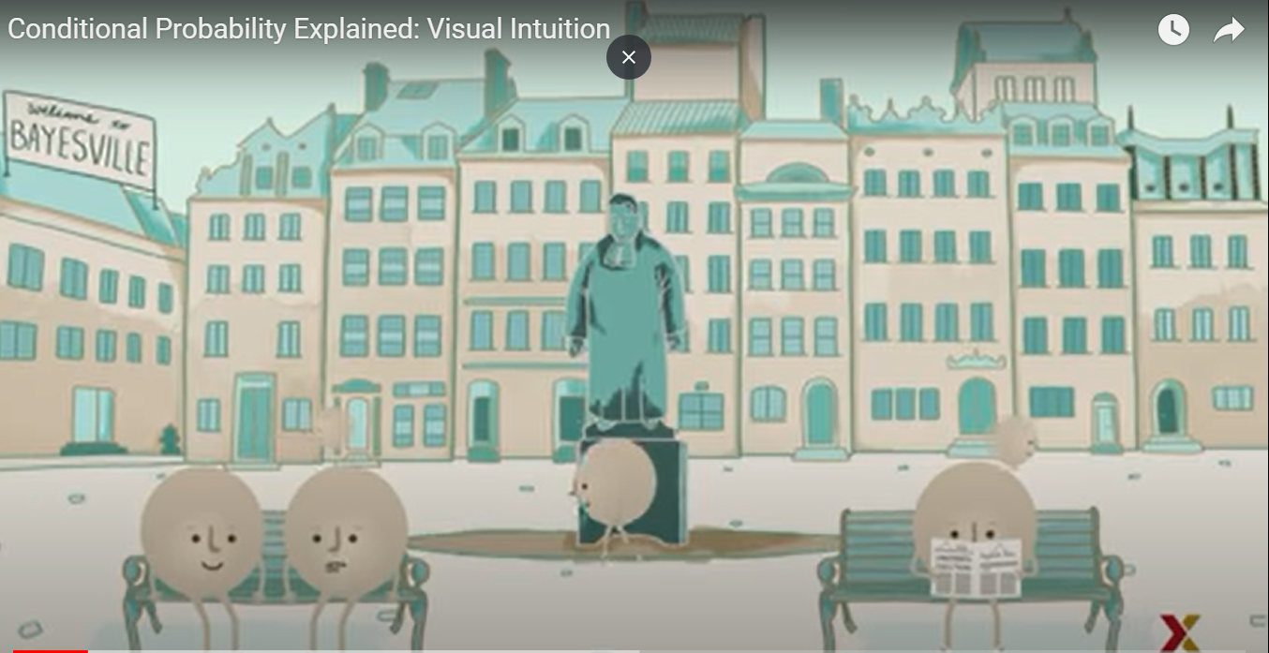

Slide 62
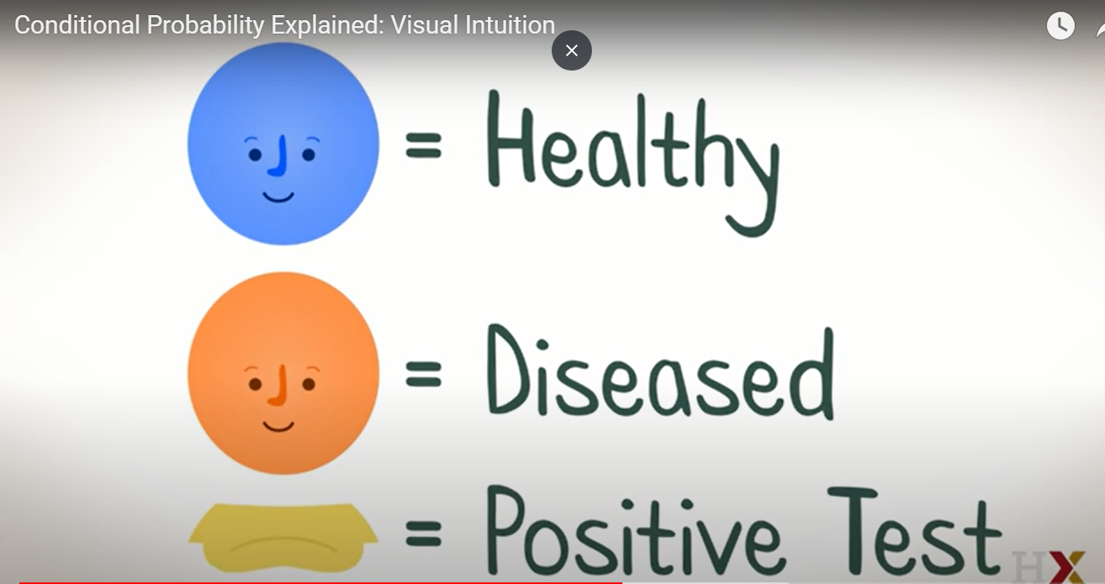

Slide 63
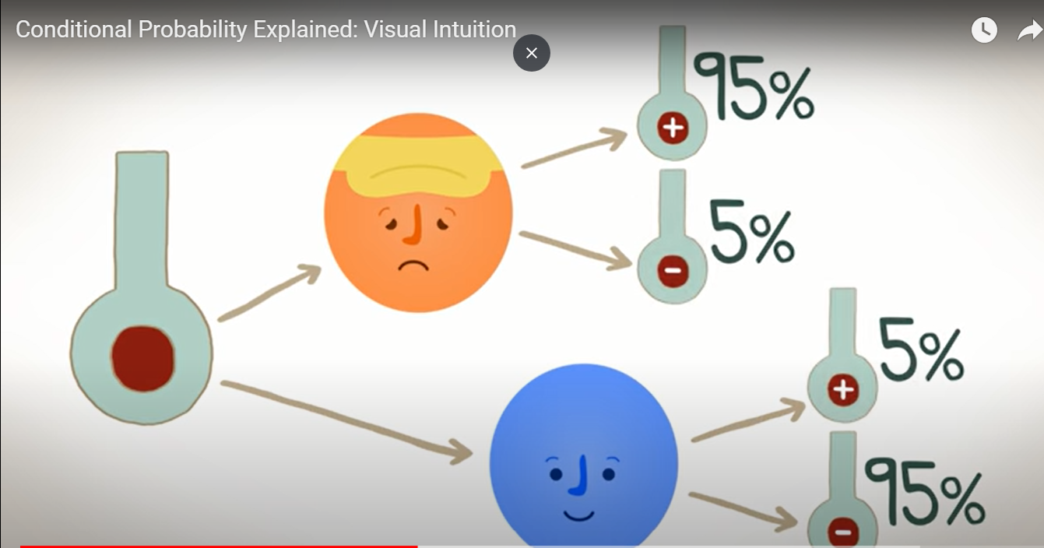

Slide 64
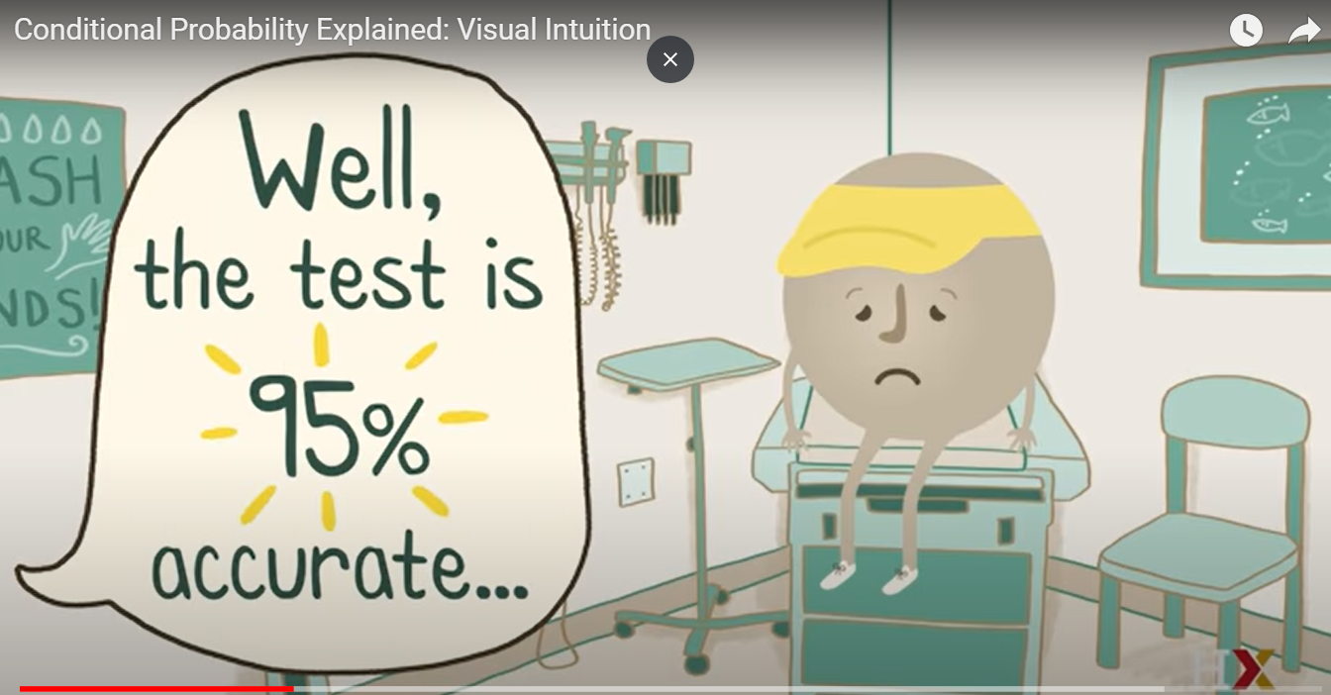
Notes:
<number>

Slide 65
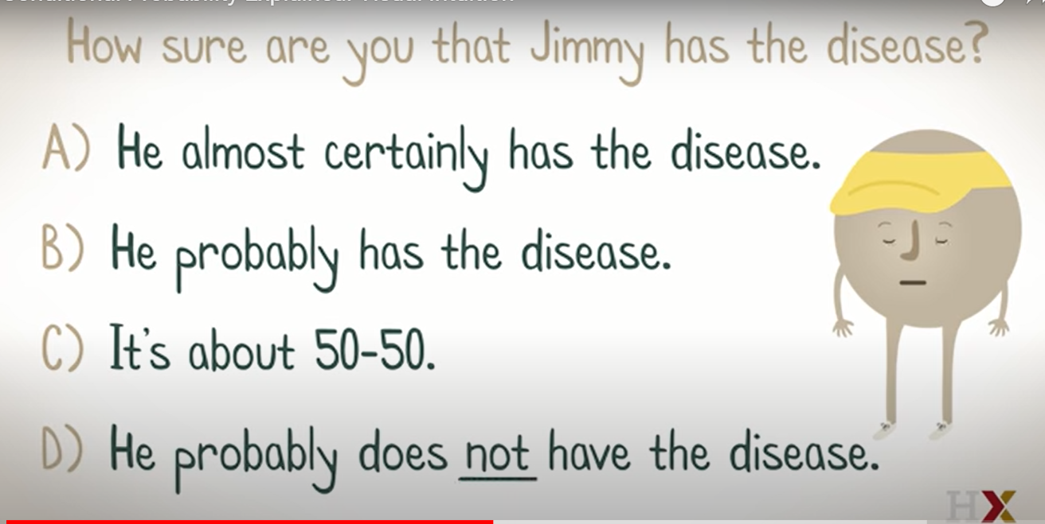
Notes:
Can’t answer!!!
We need the prevalence
True for positive predictive value
<number>

Slide 66
My mind?
Prior belief
Default action
Notes:
<number>

Slide 67
How common is the disease?
Prevalence
1%

Slide 68
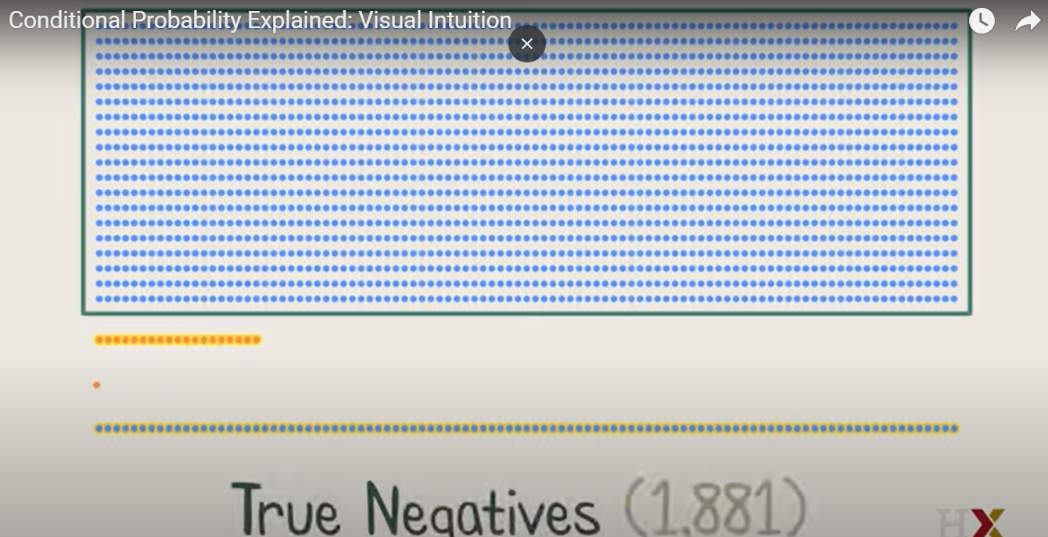
Notes:
Are they of equal importance to me?
Which one u thing is the false positive ?
<number>

Slide 69


Is this good?
Notes:
Maybe it’s not bad
Maybe we need this test to exclude, and if we have false positive, we can head to a better test with higher specificity
<number>

Slide 70


Slide 71

Notes:
Conditional Probability Explained: Visual Intuition - YouTube
https://www.youtube.com/watch?v=by3_weGwnMg
<number>

Slide 72

Heart of bayes theorem?
Notes:
Base Rate Fallacy - Biases & Heuristics | The Decision Lab
https://thedecisionlab.com/biases/base-rate-fallacy/
<number>

Slide 73

مدينة السمبلاوين
85% are blue and 15%
are green.
Notes:
Example 1 - The cab problem
This classic example of the base rate fallacy is presented in Bar-Hillel’s foundational paper on the topic.¹¹ First, participants are given the following base rate information. There are two cab companies in a city: one is the “Green” company, the other is the “Blue” company. The names of the company refer to the colors of their respective taxis. It is specified that, of all the cabs in the city, 85% are blue and 15% are green.
<number>

Slide 74



Hit and run
Notes:
Then, a scenario is described in which a cab, which a witness later identifies as green, was involved in a hit and run one night.
<number>

Slide 75

Probability that hit was by green car?
witness can accurately distinguish the colors 80% of the time but confuses them 20% of the time
Notes:
In order to assess the reliability of the witness, the court ordered that their ability to discriminate between blue and green cabs at nighttime be tested. It is shown that the witness can accurately distinguish the colors 80% of the time but confuses them 20% of the time. Participants are then asked to give the likelihood that the cab involved in the hit and run was actually green.
<number>

Slide 76
Base rate neglect
85% are blue and 15%
are green.
P(witness correct) = 41%.
Notes:
Many people are inclined to respond that the probability that the witness correctly identified a green cab at night is 80%. However, everyone who gives that answer is committing the base rate fallacy. When taking into account the base rate information, which tells us that only 15% of the cabs in the city are green, the actual probability that the witness was correct is 41%. This probability is achieved through inferential statistics calculations, which take into account both the percentage of each color cab in the city and the likelihood that the witness correctly discriminated between the colors at night.
<number>

Slide 77

Rule 1
Notes:
U focused on likelihood (results) that tom is shy
And forgot about prior, number of students in each major
This is very common and it is called “bayes rate neglect”
<number>

Slide 78

Notes:
What’s the probability that if he left the kitchen and took a look of the balcony that he will come back and kidnap the kids?
<number>

Slide 79


Slide 80

Should have this effect

Slide 81

Why 80:10 - why 1:100?
Notes:
Sure u can take precautions
But it totally differs if u are taken precautions because something will happen for sure
Or if u know it is still not common ( so u won’t freak out) and u still take the precautions
<number>

Slide 82

Notes:
Are people expected to know the probability of a repair’s man being a robber? No
<number>

Slide 83

The question is:
Notes:
Did u consider it?
Rationality is not about knowing facts
It’s about knowing which facts are relevant
<number>

Slide 84


How to deal with info?
Notes:
Bob is jealous from amy
The likelihood: one time amy didn’t finish a project she was assigned
Bob is complaining about amy not finishing the project
<number>

Slide 85


Slide 86

What if not jealous?
Notes:
If he wasn’t jealous, there is still a high probability that he would complain about her
<number>

Slide 87

Update rationally

Slide 88

Rule 2

Slide 89


Slide 90

What u think?
Notes:
<number>

Slide 91
New data
A smart friend tells u meditation is useful
What to do?
Notes:
<number>

Slide 92

Update a bit!
It depends
Notes:
Depends on ur prior.. Were u sure that meditation was fake?
Is ur friend related to meditation?
Apart from being smart? Do u trust him?
<number>

Slide 93


More and more info?

Slide 94

3 rules

Slide 95

Want more info?
Notes:
A visual guide to Bayesian thinking - YouTube
https://www.youtube.com/watch?v=BrK7X_XlGB8
<number>

Slide 96
Heart of bayes’ theorem?
???

Slide 97


Slide 98

Maybe we differ
Notes:
But how we update our beliefs is what really matter
<number>

Slide 99

Notes:
More precise calculate using calculus or a computer
<number>

Slide 100

Notes:
StatQuest: What is a statistical distribution? - YouTube
https://www.youtube.com/watch?v=oI3hZJqXJuc
<number>

Slide 101


How to choose?
Why to choose?
Notes:
Normal
Binomial
Exponential
Gamma
Pdf
Pmf
<number>

Slide 102

Pause a minute

Slide 103

Pause a minute

Slide 104

Is the study worthless?
As good as the assumptions
Notes:
Does this mean that the study is worthless? No, but it’s only as good as the assumptions you’ll make about it. Since there’s very little that we know for sure from its data, the only way to make inferences beyond the facts is to bridge the gap with assumptions. That’s all statistics is. Assumptions, not magic.
Unfortunately, we’re not all equally qualified to make good assumptions that lead to useful conclusions. For example, while I am a statistician with plenty of real-world data collection experience, I’m not an expert in antibody tests, so you shouldn’t trust me to make wise assumptions about their accuracy. Excellent! I don’t trust me either, so I’ll end up learning nothing about the virus exposure rate of NYC. The study is worthless in my hands.
<number>

Slide 105
How to choose?
Why to choose?
Notes:
Normal
Binomial
Exponential
Gamma
Pdf
Pmf
<number>

Slide 106

لولو من أبولو
Notes:
<number>

Slide 107

It differs
Notes:
List of Probability Distributions - Stat Mania English
http://en.statmania.info/2015/08/list-of-probability-distribution.html
<number>

Slide 108
Choosing Your Distribution
1- assume a distribution
2- other solutions (to be continued …)
Notes:
They either (1) estimate empirical distributions from their data — using, you guessed it, histograms! — or they (2) make theoretical assumptions about which member of a popular distribution catalog looks most similar to how they believe their data source behaves.
3) Kernel density without assumptions
MLE or method of moment
Or kernel density estimation
Or use bootstrap
I need to read Tom’s lectures
<number>

Slide 109

Which distribution?

Slide 110

Popular distributions
Notes:
On the plus side, named distributions come with neat PDFs and a bunch of calculations pre-done for you.
On the minus side, your application might not fit anything in a catalog. Thanks for the empirical option.
For the empirical, I think it may be hard to generalize.
Many items, ex. Bin size can make results unpredictable
Check the medium article
<number>

Slide 111



Why do I need a distribution?
Notes:
Imagine u r in an algebra exam.
U have a formula sheet
W see the questions and u want to answer ..
What to do?
Check the questions and see which one of them fits in ur sheet
Then answer
Or u can invent or derive a formula
Which needs time, validation, etc..
<number>

Slide 112

Why wait?
Notes:
If we have our data, and we have assumed a popular distribution. Why not start plotting?
Let’s be honest — the insights aren’t exactly leaping off the page. That’s why we tend to prefer asking questions about specific parameters of interest to us. In statistics, parameters summarize populations or distributions. For example, if you’re asking whether the distribution peaks at zero, you’re asking about the location of its mode (a parameter). If you’re asking how fat the distribution is, you’re asking about its variance (another parameter). In a moment, I’ll take you on a tour of a few of my favorite parameters.
<number>

Slide 113

Without parameters ☺
Notes:
If you look at the function above, you’ll notice that there are some Greek letters in there: μ and 𝜎.*** These are special parameters for this distribution; until we replace them with numbers, we’re not ready to plot anything. Without them, all we can do is get a vague sense of the abstract shape of the distribution, like so:
<number>

Slide 114
لولو من أبولو
Notes:
Aren’t all of these are normal distributions?
<number>

Slide 115

Normal distribution
http://shiny.calpoly.sh/Prob_View/
Notes:
There’s plenty more Greek to enjoy, since other distributions use other characters for their special quantities.
<number>

Slide 116
Pause a minute

Slide 117

More info?
This is part 1
Notes:
Getting to know probability distributions | by Cassie Kozyrkov | Mar, 2021 | Towards Data Science
https://towardsdatascience.com/getting-to-know-probability-distributions-cc1dd1e2f22b
<number>

Slide 118

Theme

Slide 119

Normal distribution

Slide 120
visualize
https://istats.shinyapps.io/NormalDist/

Slide 121
Real life example
View data locally (R studio)
Notes:
Zprojects/ran/starting 2020-2-15/requiredanalysisforpatientcost/new_tasks.Rmd
<number>

Slide 122
Why so important?
Statistical tests visualized (Local pdf )

Slide 123

Notes:
which_test_flowchart.png (6131×2669)
https://onishlab.colostate.edu/wp-content/uploads/2019/07/which_test_flowchart.png
<number>

Slide 124

Does it really matter?
P value parametric: 0.04
P value non par. : 0.63
Notes:
Look at mean and median for both males and female
Look how females are right skewed
GraphPad Prism 9 Statistics Guide - The Mann-Whitney test doesn't really compare medians
https://www.graphpad.com/guides/prism/latest/statistics/stat_nonparametric_tests_dont_compa.htm
<number>

Slide 125



Normality tests

Slide 126
Can we avoid this assumption?
See you next week

Slide 127
Lefthanded project
https://www.datacamp.com/projects/479

